Slide 1
C# Professional Level 1
Classes (Advanced)

Slide 2
Chapter content
01
02
03
04
Members
Const keyword
Static keyword
Operators
05
06
07
Members
Equality
Casting

Slide 3
Members
Field
Method
Event
Operator
Indexer
Constant
Property
Constructor
Destructor
Nested types
Notes:
Green: often used
Yellow: not common but used
Red: rarely used
For each member to a demo

Slide 4
Access Modifiers
Visibility levels:
public: Acces not limited
private: Access limited to the containing class
internal: Access limited to current assembly
protected: Access limited to containing class or types derived from the containing class
protected internal: protected + internal
private protected: Access limited to containing class or types derived from the containing class within the current assembly
A member cannot be more accessible than its container: a public property on an internal class is only accessible within the current assembly
Default accessibility : private

Slide 5
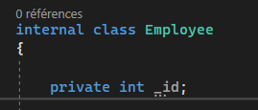
Fields
A variable of any type
Encapsulation:
Must be private (Open Closed Principle, O of SOLID)
Must be accessed through a property, method,…
Can be static (static keyword)
Can be only defined in a constructor (readonly keyword)
Naming recommendation :
camelCase
camelCase prefixed by underscore
Notes:
In object-oriented programming, the open/closed principle states "software entities (classes, modules, functions, etc.) should be open for extension, but closed for modification";^{[1]} that is, such an entity can allow its behaviour to be extended without modifying its source code.

Slide 6
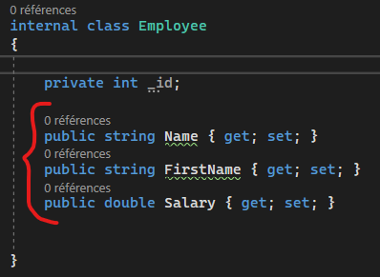
Properties
Pair of methods to get/set field values inside a class
Get method: returns the associated field’s value
Set method: no return value, sets the value in the associated field
Auto property, the backing field is created by the compiler: T Prop {get;set; }
Property set at construction time: T Prop {get;}
Expression body on property:
string Name => First + ‘’ ‘’+ Last
string Name { get => _name; set => _name = value }
Initializer for auto property:
public string Hello {get;set;} = ‘’world’’
Naming recommendation :
Pascal case
Verb: DoSomething
If returns bool : IsSomething

Slide 7
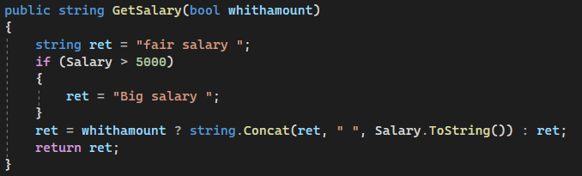
Methods
Visibility
Return type
Name
Parameter(s)
Signature
Body
Exit the method returning the value on the right

Slide 8
Method parameters
Reference type: reference copy
Value type: copy
Keywords ref/out
Reference type: reference on the reference
Value type: reference on the value (no boxing)
ref: the variable must be set before
out: the variable will be set in the method
params: declares an array of parameters of a specific type

Slide 9
Method signature
Set of data for the method
Default value possible for some parameters
Variable number of argument possible (params keyword)
Method overloading : same name but different set of arguments and/or return value
Method overriding : see later with inheritance
Naming Recommendation :
Pascal case
Verb: DoSomething
If returns bool : IsSomething
Notes:
Overloading sample :
public void WriteLine();
public void WriteLine(string value);
public void WriteLine(bool value); public static string ReturnMyValue(string myValue)
{
return myValue;
}
public static int ReturnMyValue(int myValue)
{
return myValue;
}

Slide 10
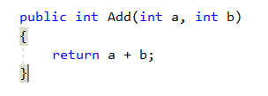

Method Expression body
C# 6 feature
Method body as an expression instead of code block
Useful for small method
Use it to increase readability
Notes:
Use when:
Not a lot of code
Return value is not a void
Code is easier to read this way

Slide 11
Constructor
« method » called when a class is created
A class can have several constructors
You can call another constructor with the keywork « this »
There is a default constructor with no parameters if no constructor is supplied
Constructor can be static
Used to initialize static fields
Called the first time the class is used for the first time
Only one, with no parameters
No visibility keyword needed
Inheritance and constructors are explained later.
Naming recommendation: PascalCase

Slide 12
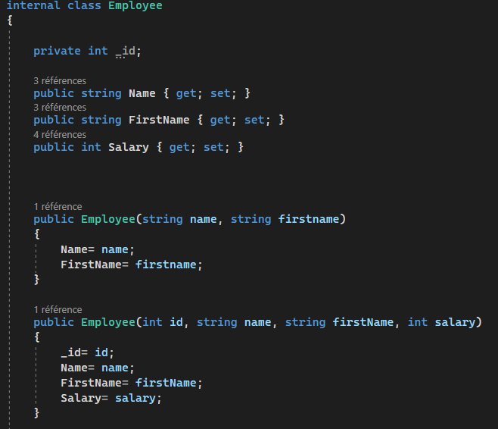
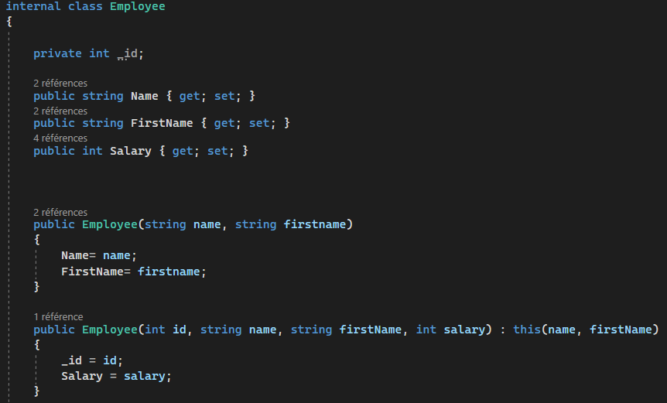
Constructor
Try to code only one constructor
Rely on one constructor to initialize all the fields and reference it from the others
Notes:
The constructor login is in only one place

Slide 13
Destructor
Only one destructor per class
Can’t be inherited on overloaded
Can’t be called. Invoked by the GC
Used in very rare case
Not the place to clear managed resources. See the chapter « managed resources »
Notes:
Destructor are only used in certain cases. For example in classes that use resources that need to be freed explicitly, File, Dll resource ...

Slide 14
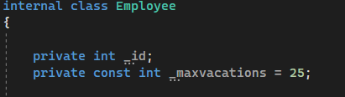
Const Keyword
Applies to fields
Known value at compile time
Value can’t change
Constant statement are replaced by their value at compile time
Constants are accessed like static fields
For public constant, prefer public static read-only properties
Naming recommendation : PascalCase

Slide 15
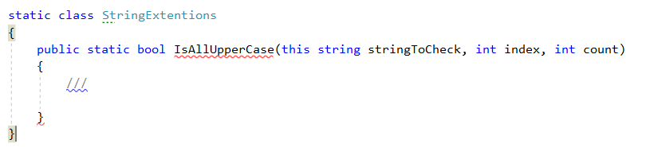
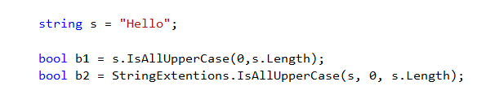
Static Keyword
Like static field: called with class name like « Console.WriteLine »
« Extension method »: simulate object method with a static method The first argument is prefixed by this: the object extended
« Extension method » works with struct and interface also

Slide 16
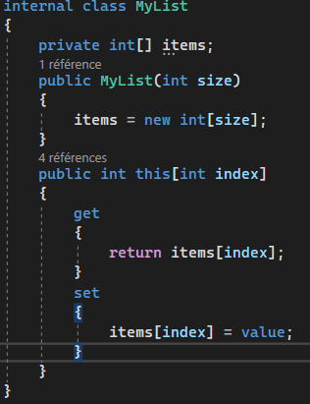
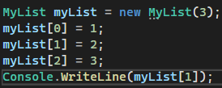
Indexer
Same model as property (but name is « this »)
But with parameters in square brackets
Can be overloaded
Mostly used in collections to access a specific element
Mimic the array syntax

Slide 17
Event
Events are a mechanism to register delegate to broadcast object event to subscribers
You can subscribe, and unsubscribe to an event
Use the keyword « event » to create an event:
« visibility » event « delegateSignature » « eventName »;
Used in the early days of C#
This is responsible of lot of memory issues because of the generated coupling (events are never unsubscribed)
There are better patterns to do that now
Please do not use it ☺ unless required by the project type (i.e. : Win Form)

Slide 18
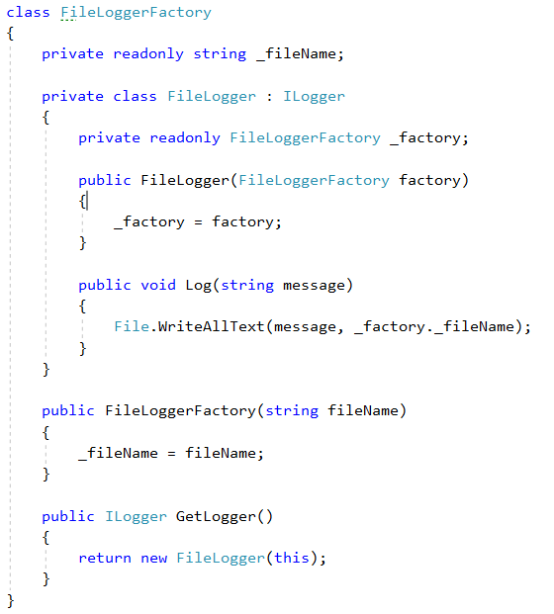
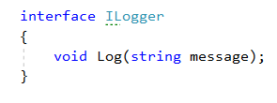
Nested type
Parent class considered as namespace
Useful to hide an implementation inside a class
The nested type have access to the parent members

Slide 19
Operator
Like static method
Unary or binary operators
Method name : operator %
One parameter must be of the same type of the class or the struct that declares the operator
Not all operators can be overloaded
+
-
!
++
~
--
*
/
%
&
|
^
<<
>>
(T)X
==
!=
<
>
<=
>=
Notes:
See Microsoft doc: C# operators and expressions - List all C# operators and expression | Microsoft Learn

Slide 20
Operator
Cast operator will be seen later
Some operators must be overloaded in pairs:
== and !=
< and >
<= and >=

Slide 21
Equality
By default: a == b is true if a & b:
are the same reference objects
are value types with same underlying values
Override Equals & == to check equality on objects.
Override GetHashCode with Equals(object):
If Equals return true, the 2 objects must have the same hashcode
GetHashCode is used in hash based containers
Check equality and compute hash code on the same object values.

Slide 22
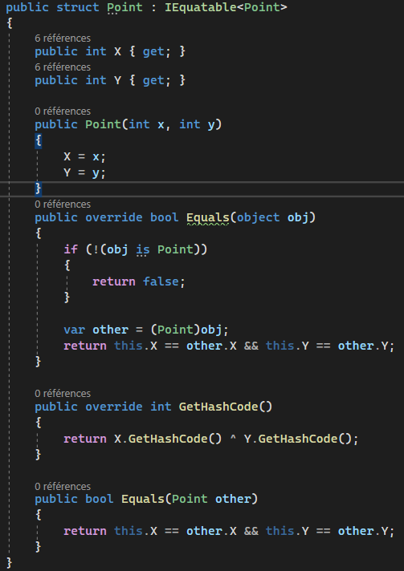
Equality on struct
By default compare all the struct fields (not very performant)
Should implement the IEQuatable<T> interface
Implement equality if necessary and check all the fields
Operator == not defined

Slide 23
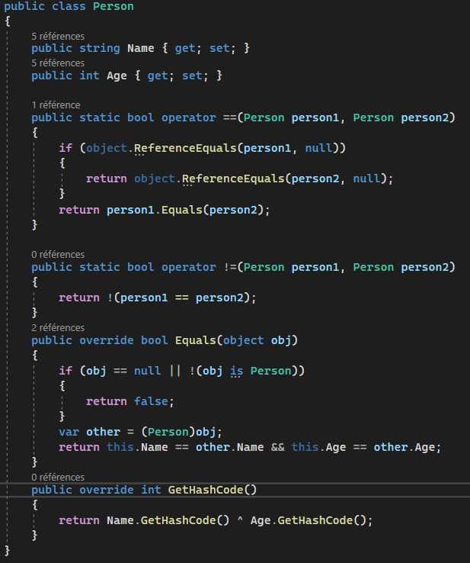
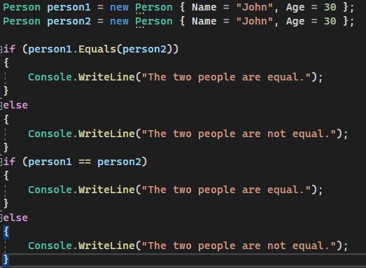
Equality on class
Because of reference field, equality is difficult to determine
Keep GetHashCode, Equals and the operation == consistent.

Slide 24

DEMO
Equality
Notes:
See README.md on the Equality project of Csharp_DemoOOP repository

Slide 25
Casting
Understand: Type conversion
Allows conversion from one type to another
Ex: int i = (int)10.0f
By convention, two types of casting
Implicit: no loss of data (int to double)
Explicit: may loss data (double to int) on numeric types
Casting can be controlled by specifying cast operators
Can be used to convert to an interface type (ex: ((IDisposable) myInstance).Dispose()

Slide 26
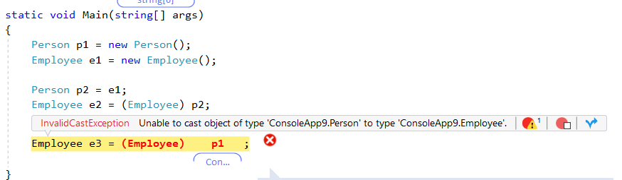
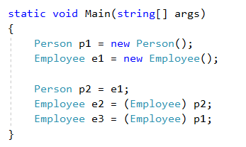
Casting operators
Explicit operator: ()
InvalidCastException is thrown if the cast is not possible

Slide 27
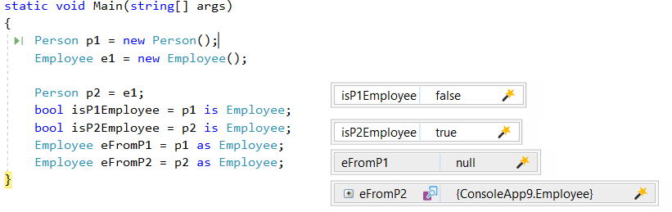
Testing cast capability
Operator is: « O is T » checks if the object O can be casted into the type T
Operator as: « O as T » returns the object casted in T, null otherwise

Slide 28
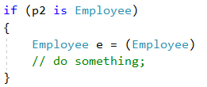
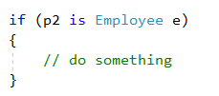
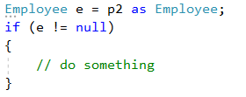
Casting
Common pattern: check type and use it
2 casts
Since C# 7
1 cast
Notes:
With C# 7 the casted variabe can be set in the test.

Slide 29
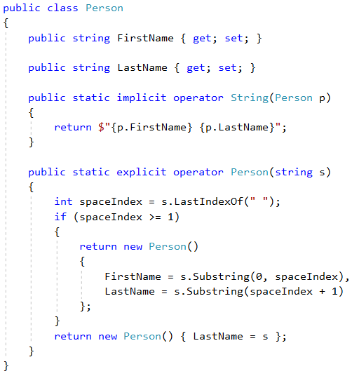
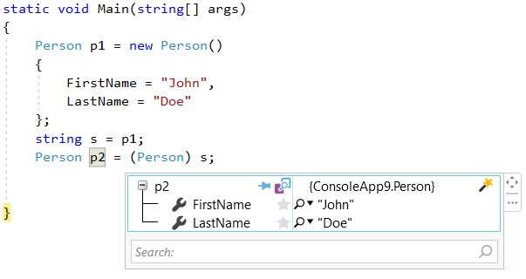
Custom casting
Custom casting handled by operators
Signature: « visibility » static (« implicit »| « explicit »| ) operator Target(Source s)
Source or Type must be the enclosing type
Implicit is the default mode if the implicit or the explicit keyword is not defined

Slide 30

EXERCISE
Implement Class Equality
Mini-project on Tech.io
Notes:
http://tech.io

